Slide 1

Unit 2: Culture spot 2
Happy Australia Day!

Slide 2
Task 1: Answer the questions.

Slide 3
Task 2: Read the text and match the headings to the paragraphs.
Crime and Punishment
The Stolen Generations
All Aboard the Convict Ship
Australia Day Today
The Clash of the CIvilizations

Slide 4
Task 3: Read the text again and match the words and definitions.
6
8
4
2
5
7
3
1
overcrowded – prenapučen
petty theft – sitna krađa
a convict – osuđenik
to found – osnovati
indigenous – autohtoni
abuse – zlostavljanje
mourning – žalost
state-run - državni

Slide 5
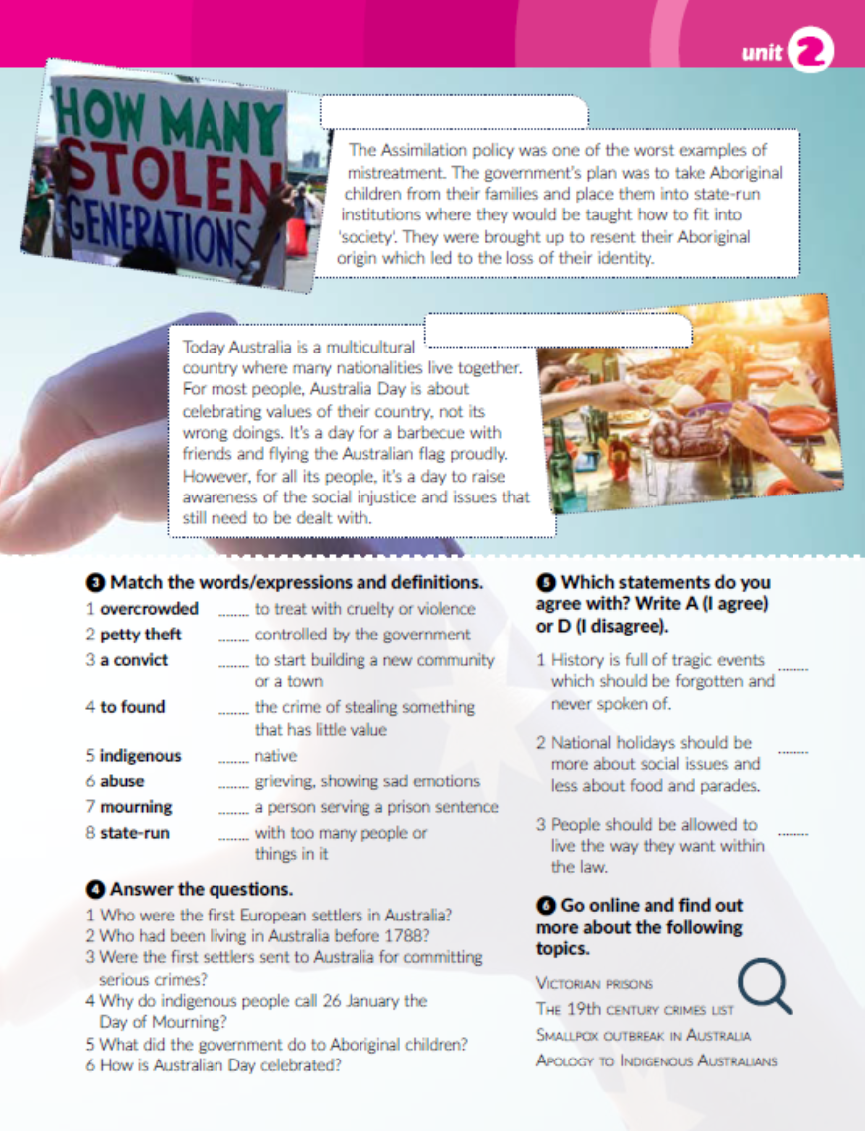
Task 4: Answer the questions.

Slide 6

Task 5: Which statements do you agree with?
Task 6: Go online and find out more about the topics in Task 6.

Slide 7

workbook, page 44

Slide 8

Otvori sljedeću poveznicu, te odaberi PLAY AND LEARN!
https://wordwall.net/play/19138/204/671

